Slide 1
Java inheritance
Dr. Asif Imran
Assistant Professor
CSUSM

Slide 2
Overview
Update on last class’s task
Discuss about project related activities
Learn about the java inheritance
Run some codes to get idea on java inheritance

Slide 3
Project proposal
By end of this week try to make sure you have a project team
Refer to canvas for important documents
Project proposal template
Link to form to put names of the team members
Specify time for proposal presentation

Slide 4
Java inheritance
Inheritance is one of the key features of OOP that allows us to create a new class from an existing class.
The new class that is created is known as subclass (child or derived class) and the existing class from where the child class is derived is known as superclass (parent or base class).
The extends keyword is used to perform inheritance in Java.
Let us see a small code…

Slide 5
In the example, the Dog class is created by inheriting the methods and fields from the Animal class.
Here, Dog is the subclass and Animal is the superclass.

Slide 6
In the example, labrador was an object of Dog.
However, name and eat() were the members of the Animal class.
Since Dog inherited the field and method from Animal, we were able to access the field and method using the object of the Dog.

Slide 7
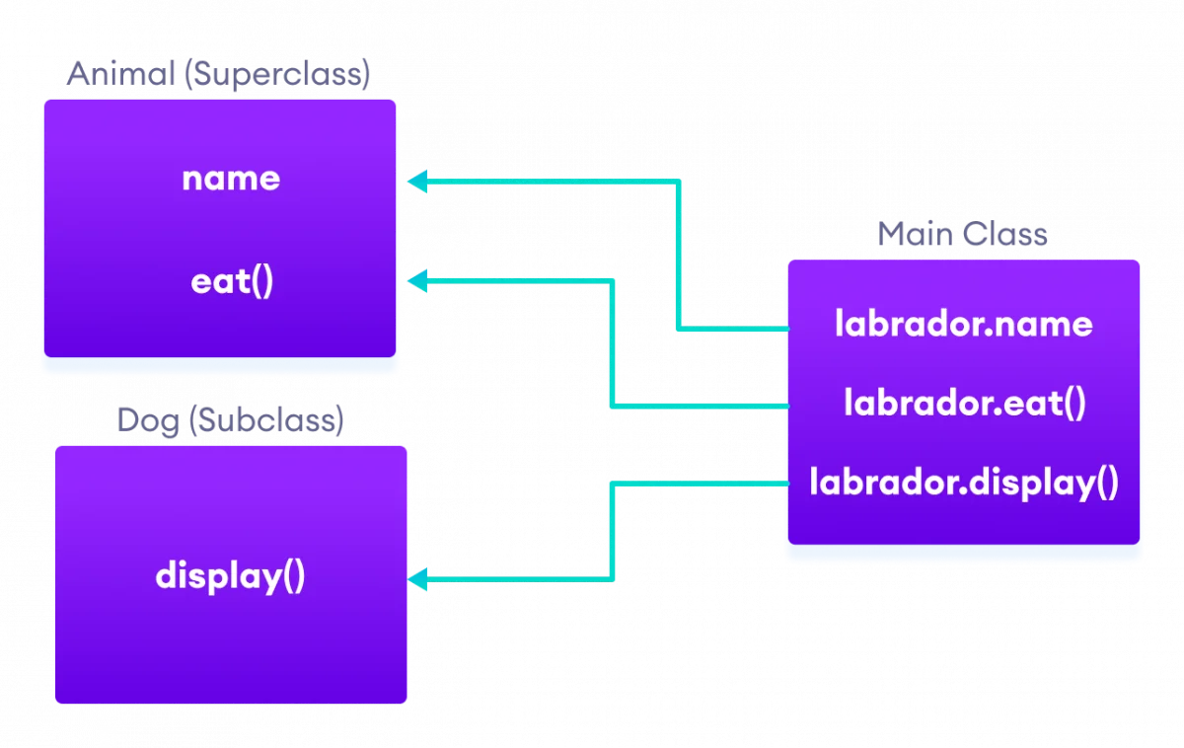

Slide 8
is-a relationship
In Java, inheritance is an is-a relationship. That is, we use inheritance only if there exists an is-a relationship between two classes.

Slide 9
Method Overriding in Java Inheritance
If the same method is present in both the superclass and subclass, what will happen?
In this case, the method in the subclass overrides the method in the superclass. This concept is known as method overriding in Java.
Let us look at an example

Slide 10
super Keyword in Java Inheritance
Previously we saw that the same method in the subclass overrides the method in superclass.
In such a situation, the super keyword is used to call the method of the parent class from the method of the child class.

Slide 11
Reference
Today’s slides have been prepared based on information from www.programmiz.com

